Slide 1
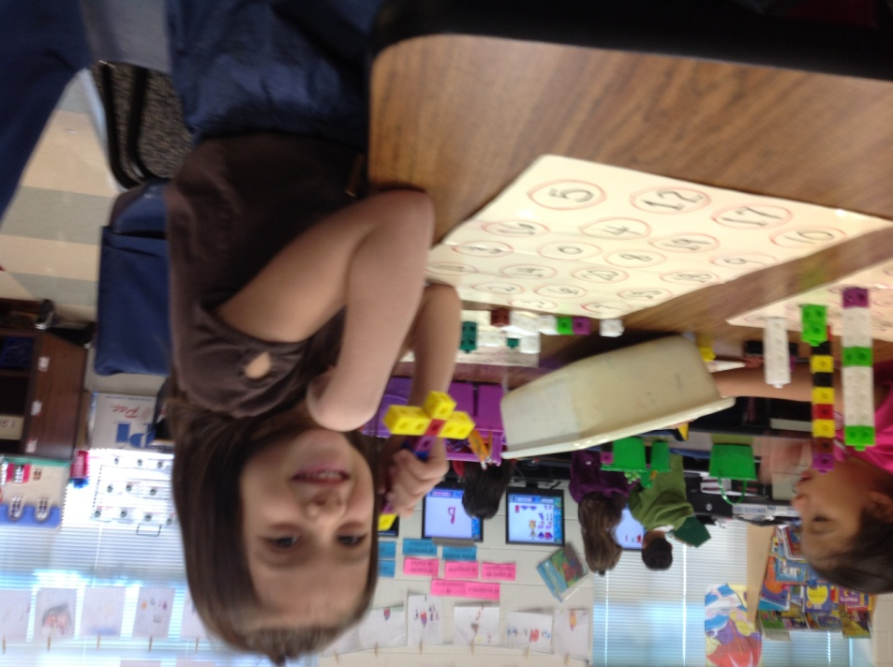
Time For Kindergarten
LISD Early Childhood Program Office
Spring 2016
Kathy Haule, haulek@lisd.net

Slide 2
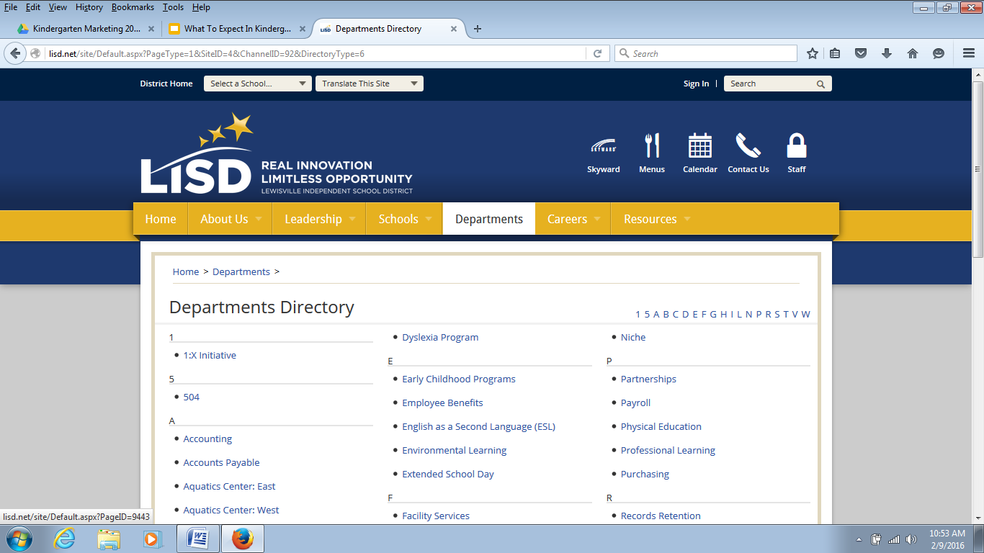
www.lisd.net
(look under Departments for Early Childhood page)

Slide 3
Student engagement
Safe, nurturing, inclusive and flexible learning environments
Meaningful and relevant work
Critical thinking
challenges
Shared responsibility
Profound learning
21ST CENTURY
Technology to access, create and collaborate

Slide 4
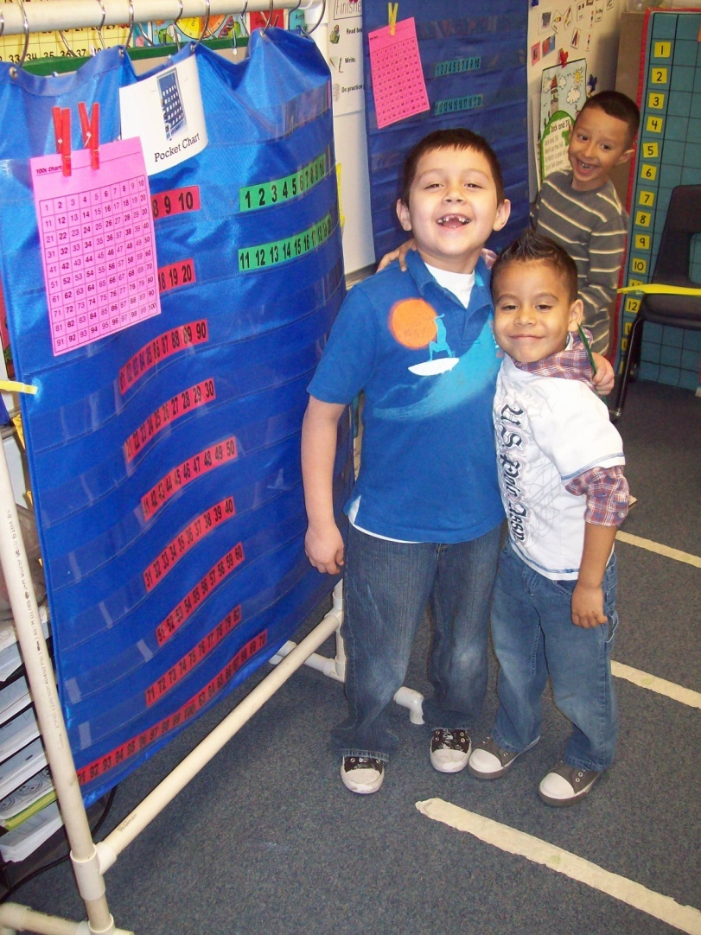
Everyone is welcome who . . .
Lives within LISD boundaries
Will be 5 on or before Sept. 1, 2016
Kindergarten is NOT REQUIRED but almost all first graders in LISD attended kindergarten last year.

Slide 5
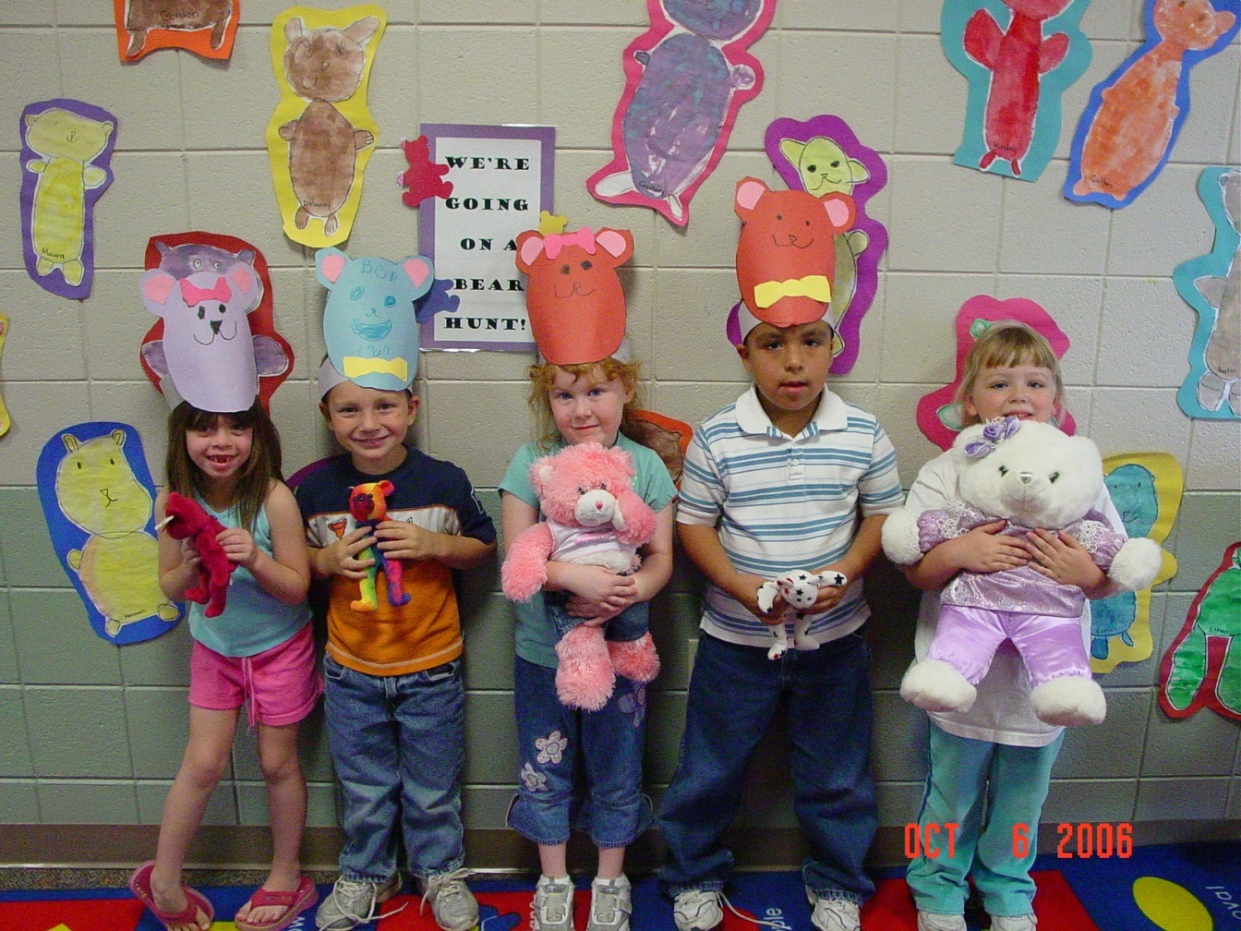
What Do You Remember About Kindergarten?

Slide 6
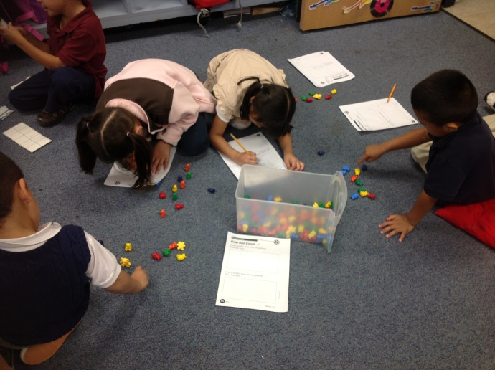
Questions You May Have . . .
What happens in kindergarten?
What should my child be able to do before starting kindergarten?
Is my child ready for kindergarten?
How will teachers keep my child from being bored in kindergarten?

Slide 7
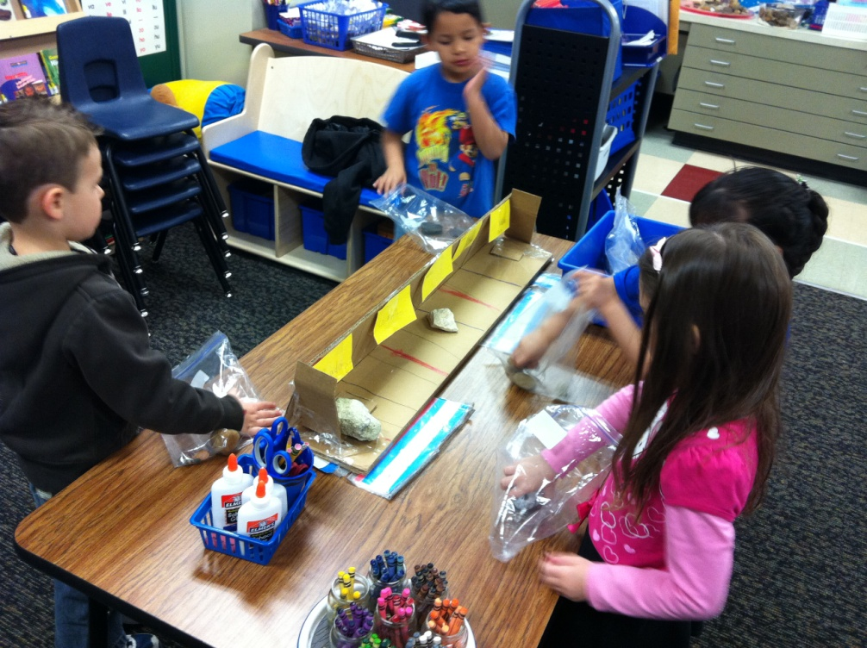
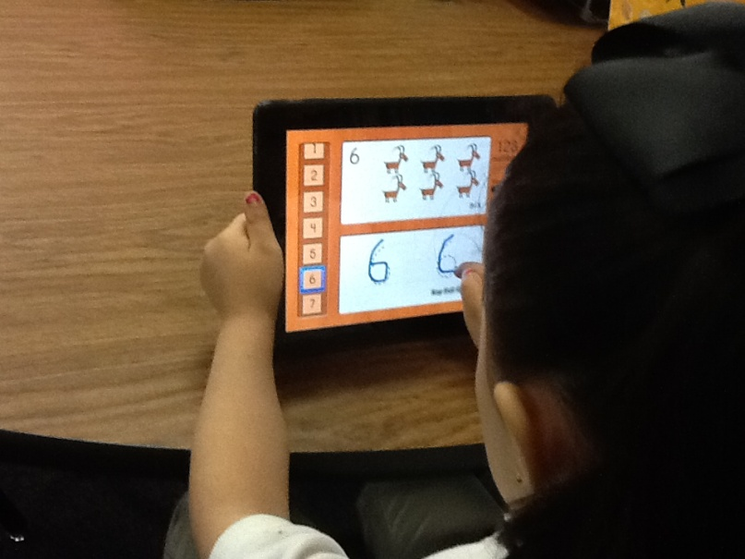
What will my child be doing in full-day kindergarten?
Notes:
Certified teachers TEKS

Slide 8
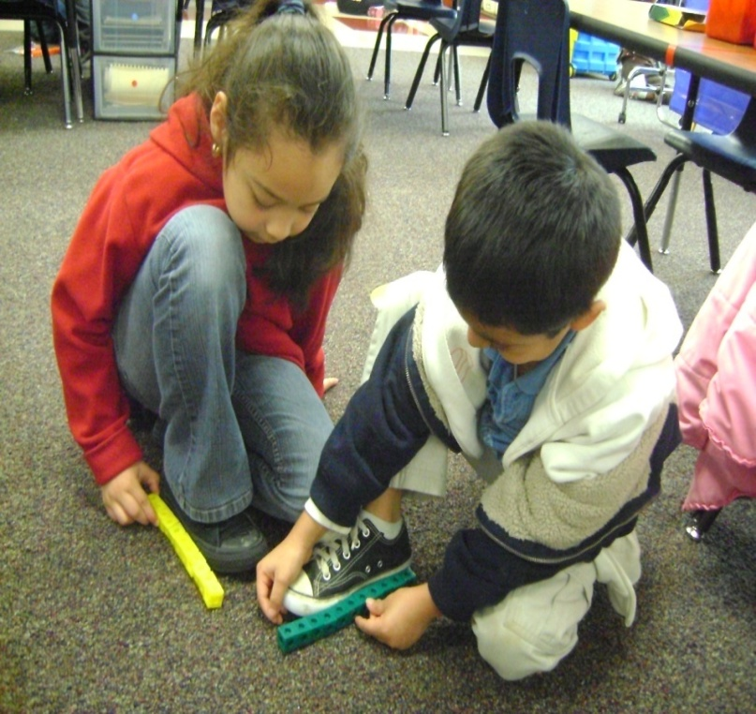
How do five-year-olds learn?
Need to feel safe, secure and valued
Creative play
Hands-on
Music, art, and movement
Real-world problems and projects

Slide 9
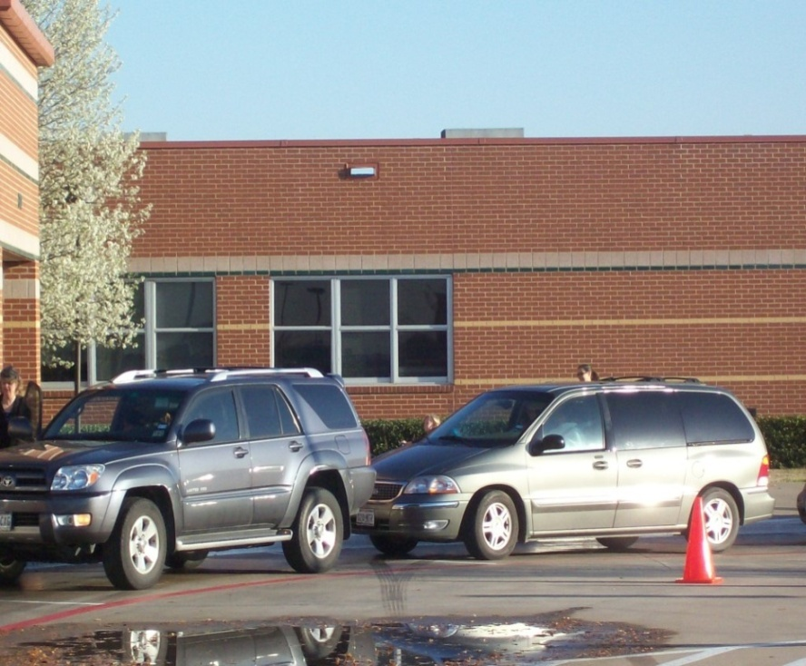
Arrival
Bus, car, van, carpool, walk, ride bikes
Follow campus procedures
Safety patrol/ crossing guards
Supervised
CLASS STARTS 7:50 AM

Slide 10
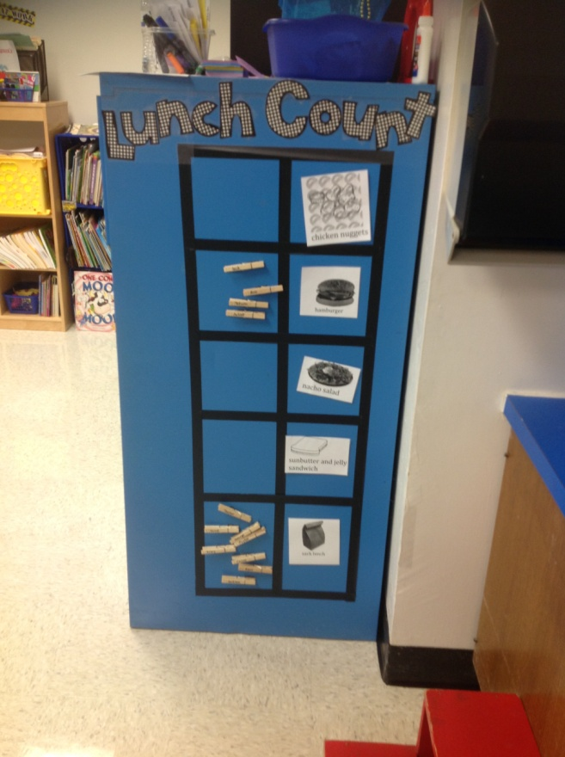
Getting the day started

Slide 11
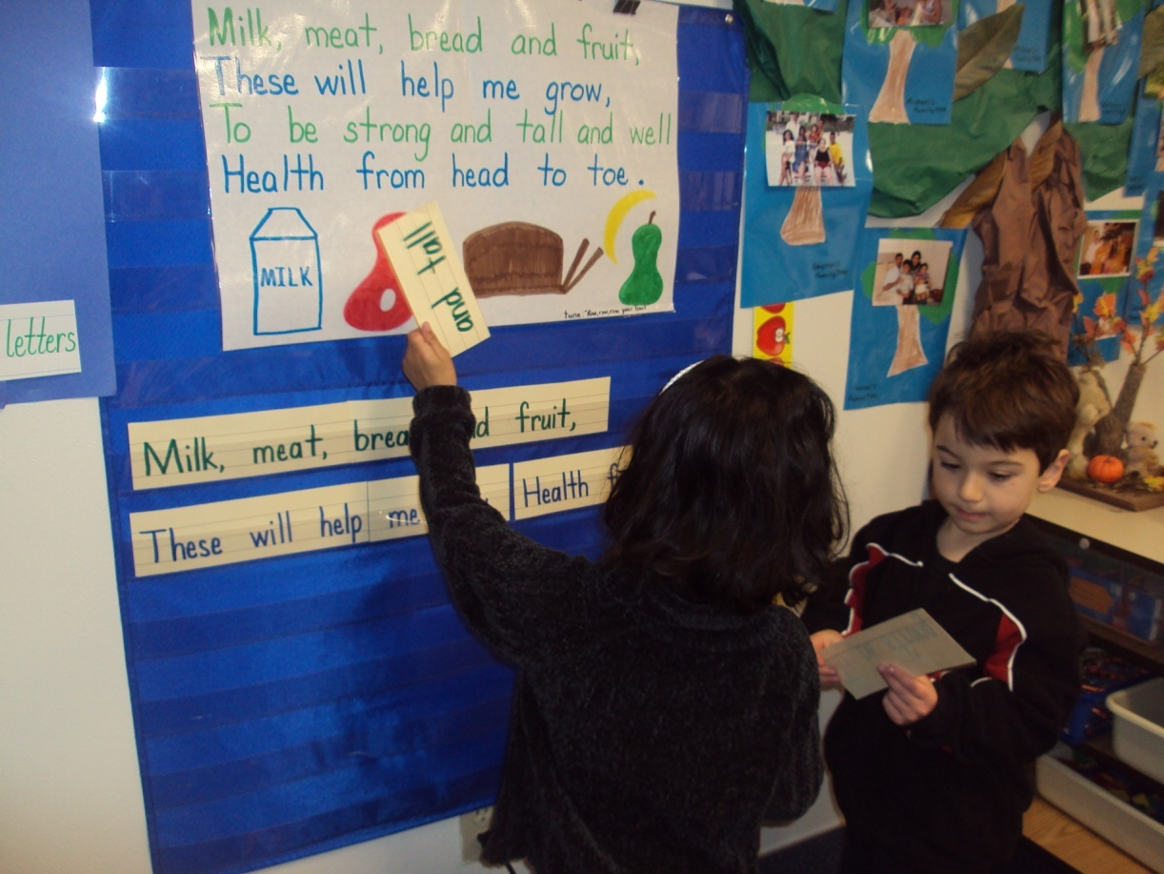
A typical day in the kindergarten classroom
Language Arts/ Social Studies
Math
Science
Specials
Lunch
Recess

Slide 12
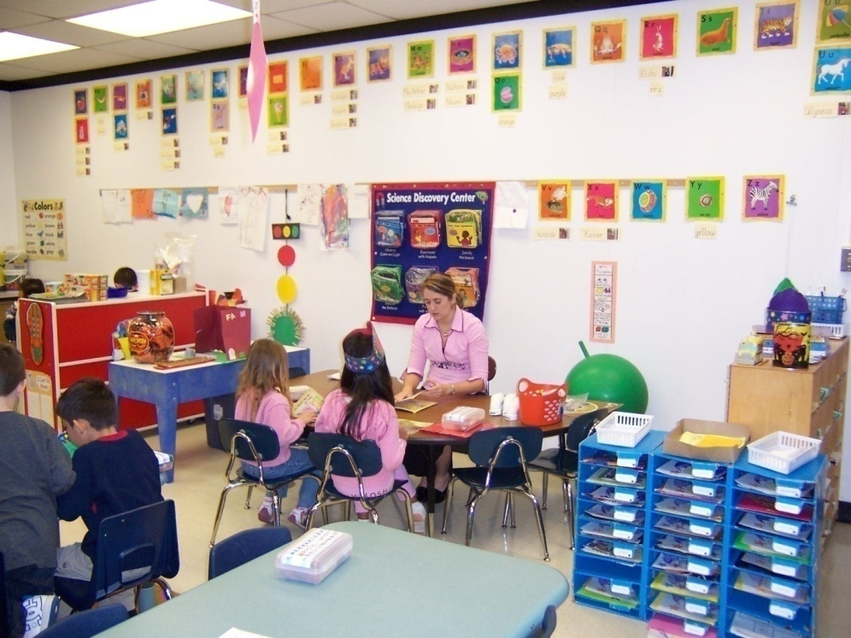
Language Arts/Social Studies

Slide 13
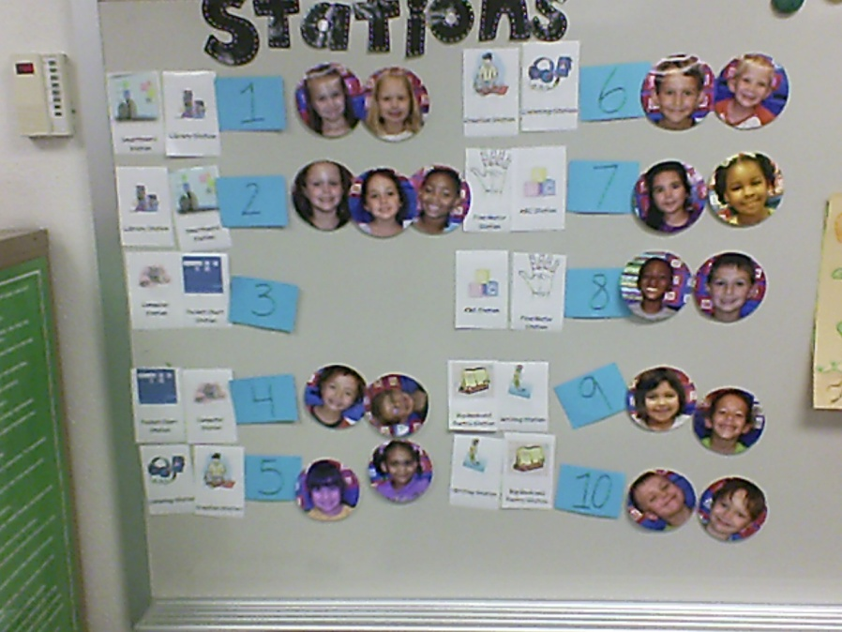
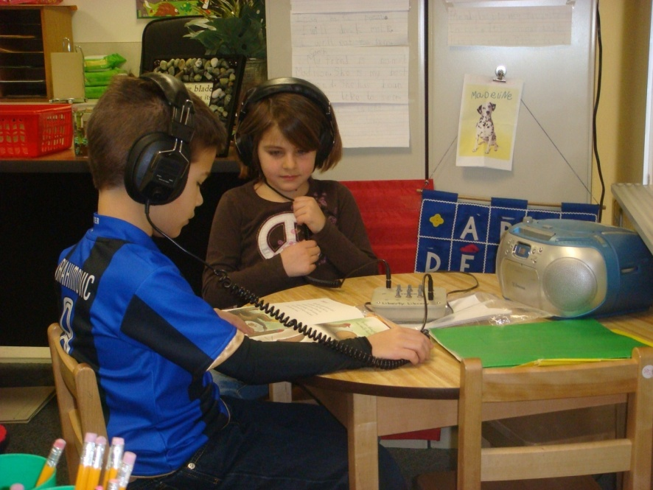
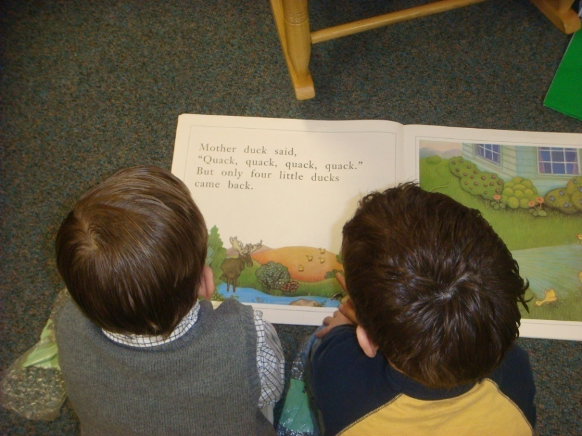

Slide 14
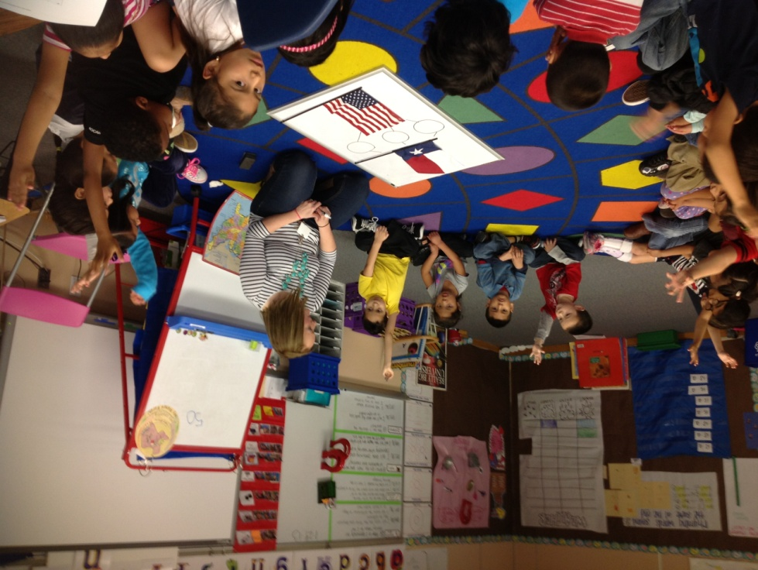
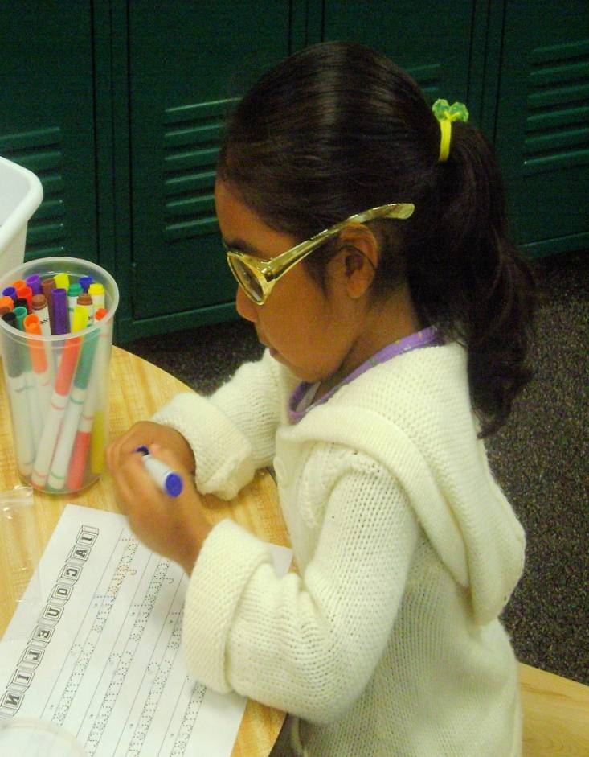
Language Arts/ Social Studies
Writing Workshop
Teacher models
Shared writing
Independent

Slide 15
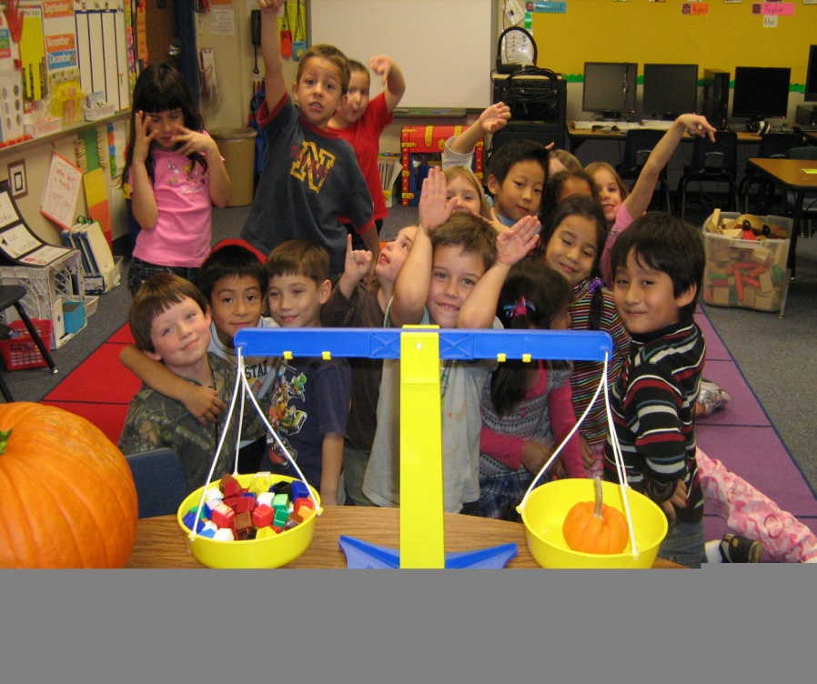
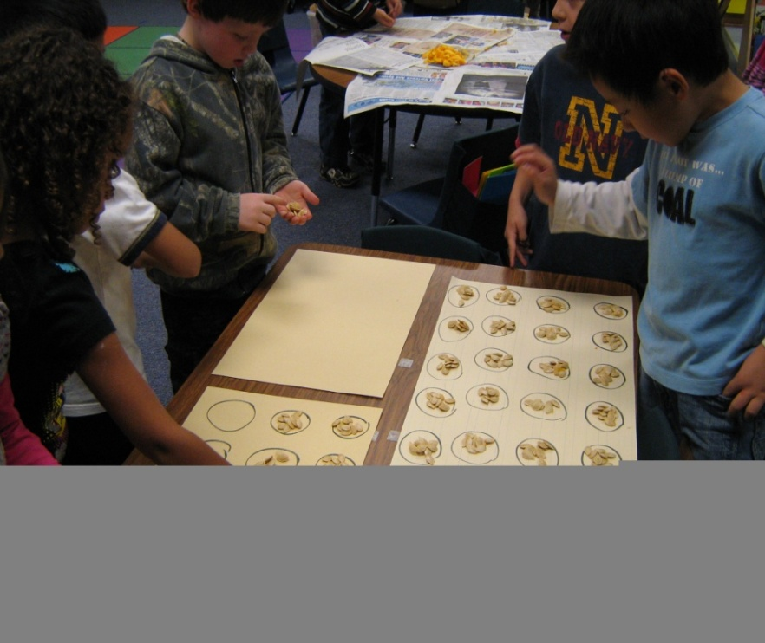
Math
Number Concepts and Patterns
Measurement
Geometry
Problem Solving Strategies

Slide 16
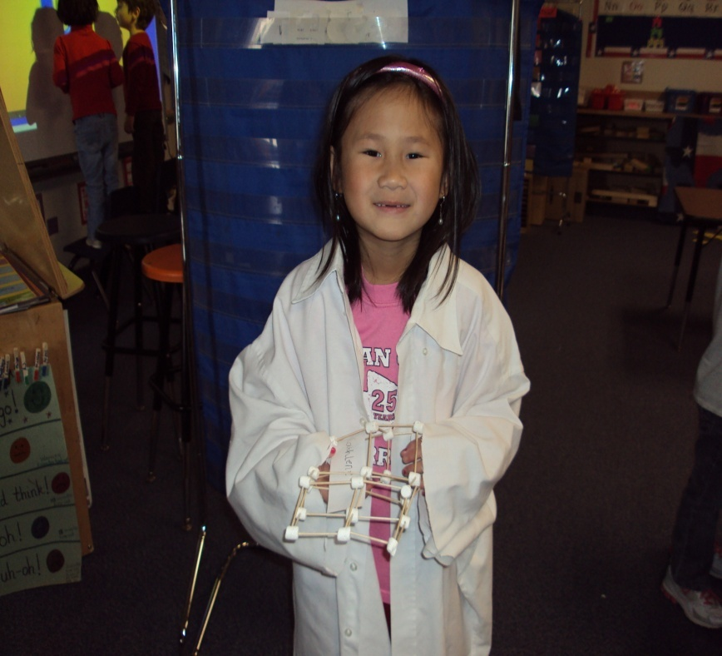
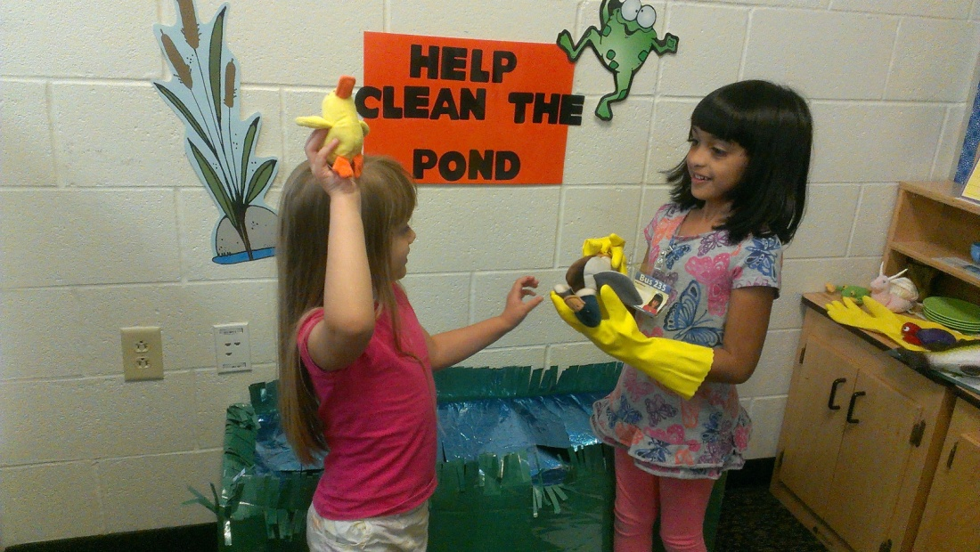
Science
Observation and Communication
Rocks
Plants
Heat/Light/ Sound
Motion and Magnets

Slide 17
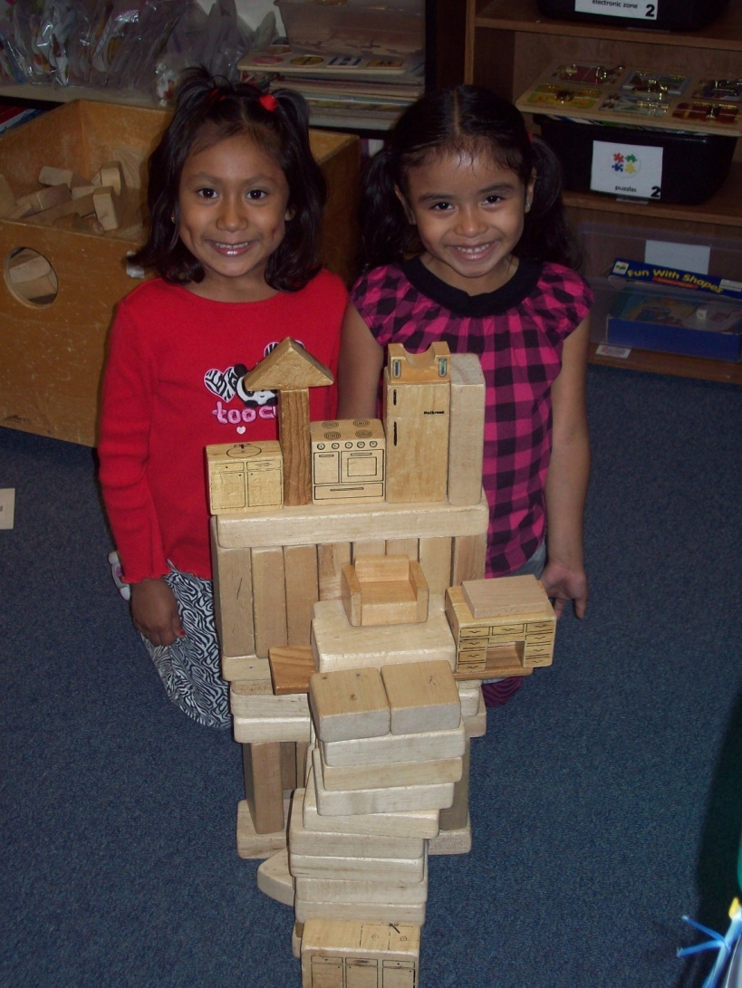
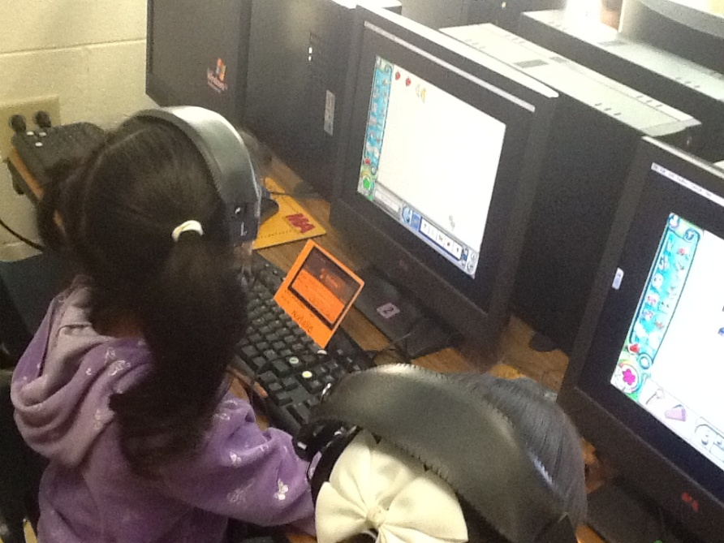
Centers
Opportunities for children to learn through activities of choice

Slide 18
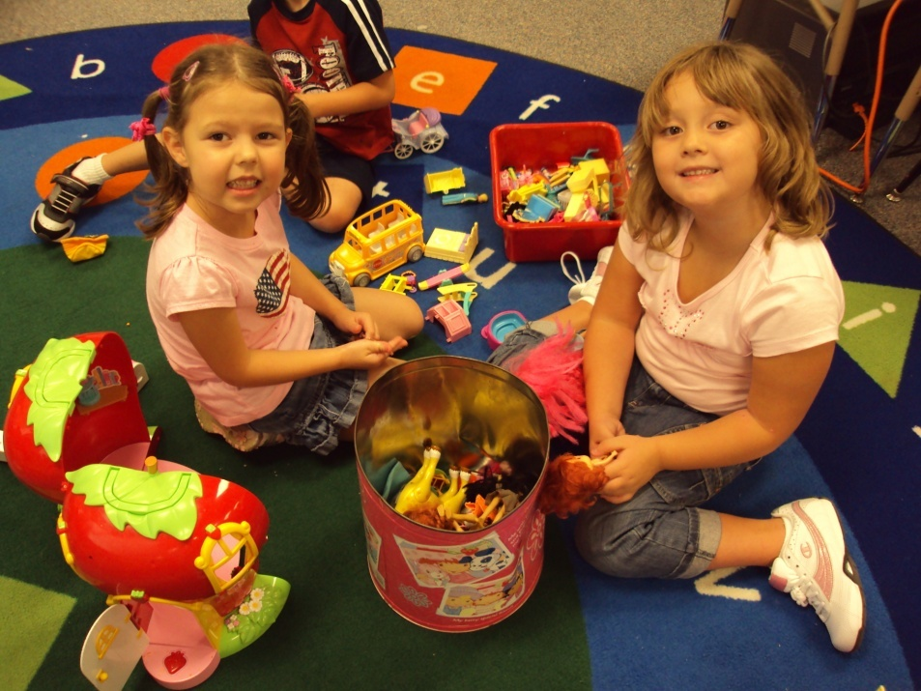
SUPPORT LEARNING IN ALL AREAS
Looks like “play”, but is how they explore their curiosities and creativity, learn to solve problems and work with others

Slide 19
Play is often talked about as if it were a relief from serious learning. But for children, play is serious learning.
Play is really the work of childhood.
Mr. Rogers

Slide 20
THERE IS A REASON FOR PLAY!

Slide 21
Specials
Physical Education (P.E.)
Art
Music
Discovery Science
Drama
Spanish

Slide 22
Library
Opportunities to check out books from the school library
Keep reading to them even when they can read themselves!

Slide 23
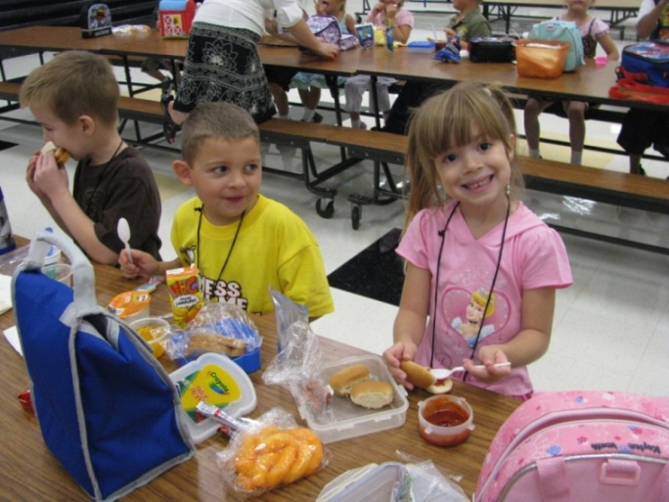
What’s for lunch?
Meals purchased through Aramark
Menus available
Pay in advance—online or at school
Free/reduced meal program
Meals brought from home
A time to learn
independence

Slide 24
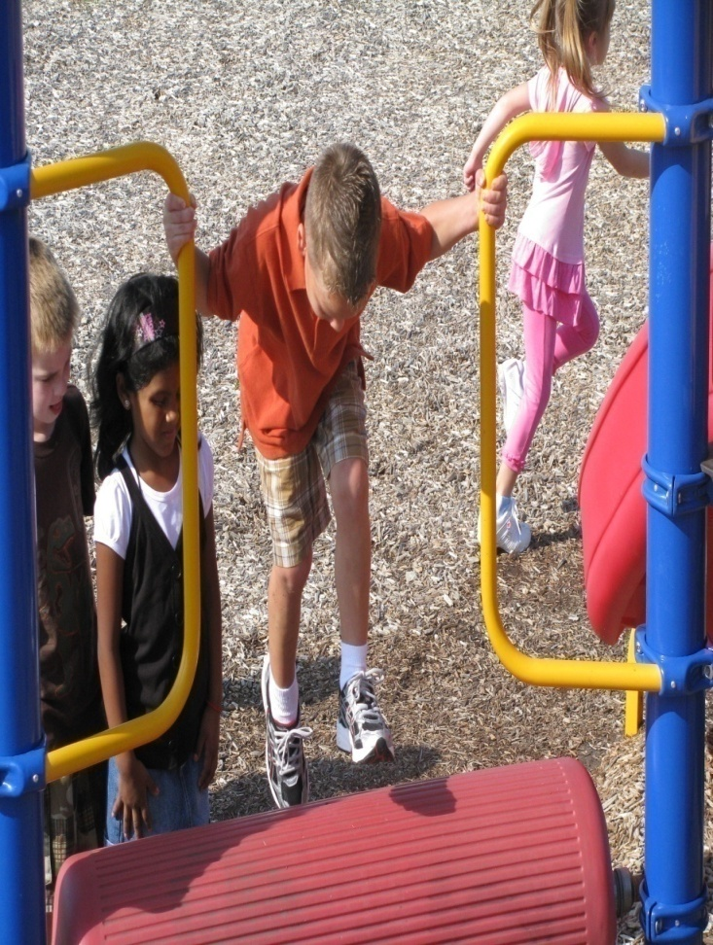
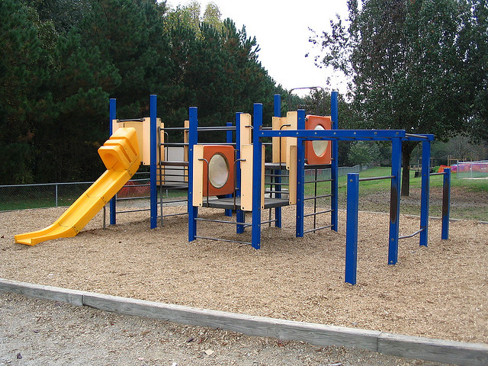
Do they still have recess?
Dress for outdoor play
Will go outside most days, weather permitting

Slide 25
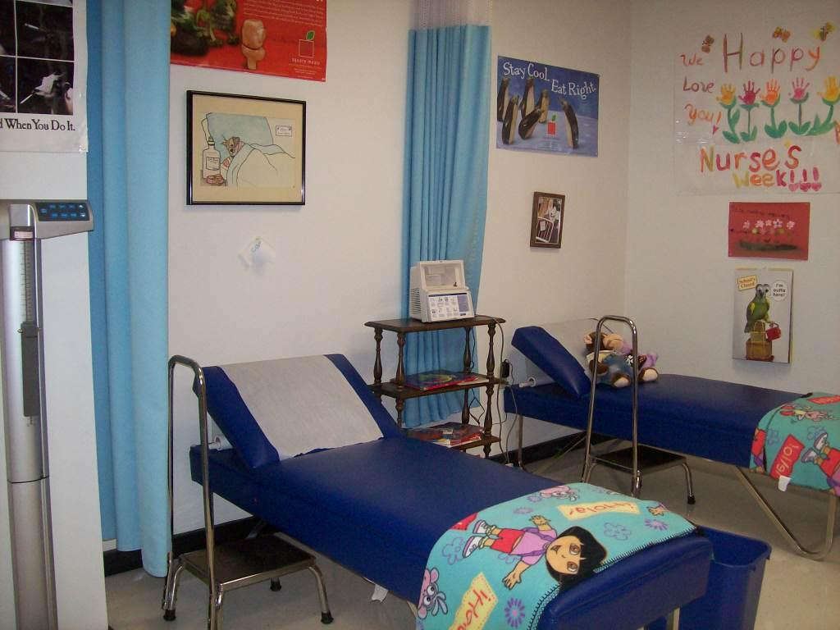
What about health & hygiene?
School nurse
Hand-washing
Restroom use

Slide 26
What about restroom use?
Most classes have restrooms in the classroom.
Group restroom breaks
Encourage independence!

Slide 27
AFTER SCHOOL
Many private child care centers provide transportation from LISD schools.
LISD offers Extended School Day (ESD) at most elementary schools.
Open until 6:30 p.m. on all school days
April 14- May 2--Registration for families currently in ESD to add siblings
May 17-19th—Registration for new families where space is available

Slide 28
How will I know how my child is doing?
Report cards every nine weeks
Reports on early literacy assessments
Scheduled Parent/ teacher conferences
Teacher conference periods
Can contact teacher by phone/ email to get information/ schedule conference

Slide 29
What If My Child Needs Special Help?
Teacher and other campus staff provide support; coordinate with parents
Evaluation for special education services
If eligible, special education services including speech, physical, occupational therapy and academic support

Slide 30
What are the most common questions kindergarten teachers hear from parents?
Is my child ready for kindergarten?
How will you challenge my child?
???????

Slide 31
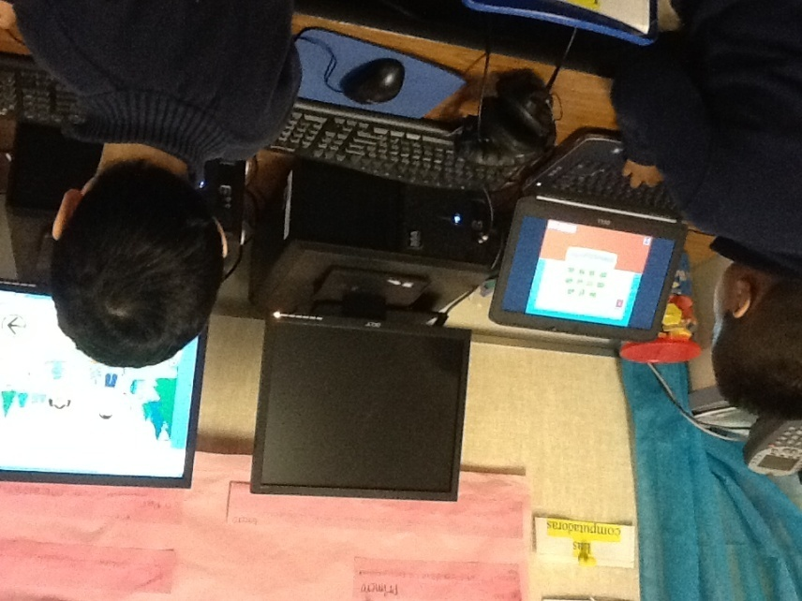
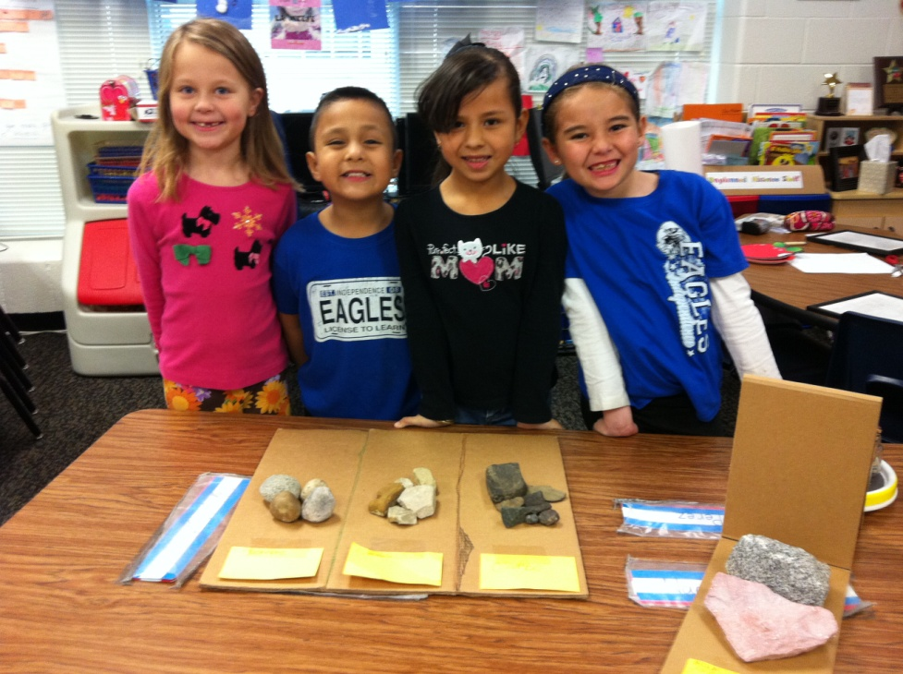
Is your child ready for kindergarten?
It is our job to be ready for your child, not your child’s job to be ready for us!

Slide 32
Common Reasons Parents Consider Delaying Entry to Kindergarten
My child isn’t ready---he’s too immature.
Kindergarten has become too academic--I want to be sure my child is ready for that.
If my child is older, he will be more successful in sports.

Slide 33
Research Shows . . .
The opportunities a child has before entering kindergarten make a bigger difference than the child’s age at entry.
We are ready for your child!

Slide 34
How will you challenge my child?
Flexible grouping
Differentiated instruction
In class enrichment experiences
Frequently in coordination with facilitator of gifted/talented program
Kindergarten acceleration

Slide 35
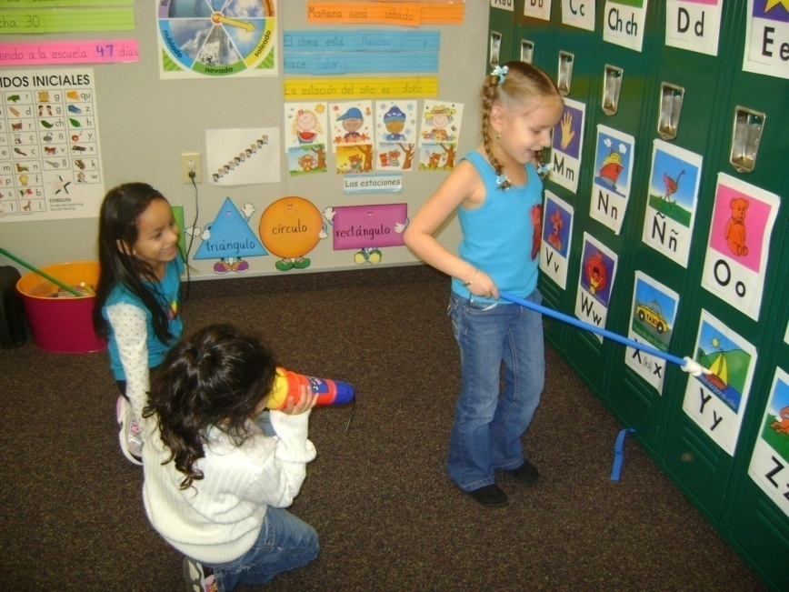
Spanish Immersion & Dual Language
Parents may choose to have their child participate in order to learn Spanish
Enter in kindergarten or first grade only
Commitment through fifth grade

Slide 36
TWO WAY DUAL LANGUAGE
Classroom 1
Group A
Academic Spanish
50% of the time
Classroom 2
Group B
Academic English
50% of the time
Spanish Learners— Speakers of languages other than Spanish
English Learners– Speakers of language other than English

Slide 37
SPANISH IMMERSION &
DUAL LANGUAGE
DUAL LANGUAGE
Camey
Creekside
Hedrick
Independence
Lakeland
Lewisville
Parkway
Peters Colony
Southridge
Vickery
SPANISH IMMERSION
Hicks
Prairie Trail
Wellington
Open to students from other school zones; priority given to those from these zones
Notes:
If interested, stay with me at the end of this session for more details and application information

Slide 38
What do kindergarten teachers want parents to know?
???????
Let your child be independent!
Open containers in lunchbox, put on shoes, use restroom, use scissors
Encourage your child to interact with others—
Sharing, making friends, playing
Limit use of technology
Kindergarten is more than ABCs and 123s…it is an experience. It’s social learning, cognitive development and so much more. It’s learning to be a learner.

Slide 39
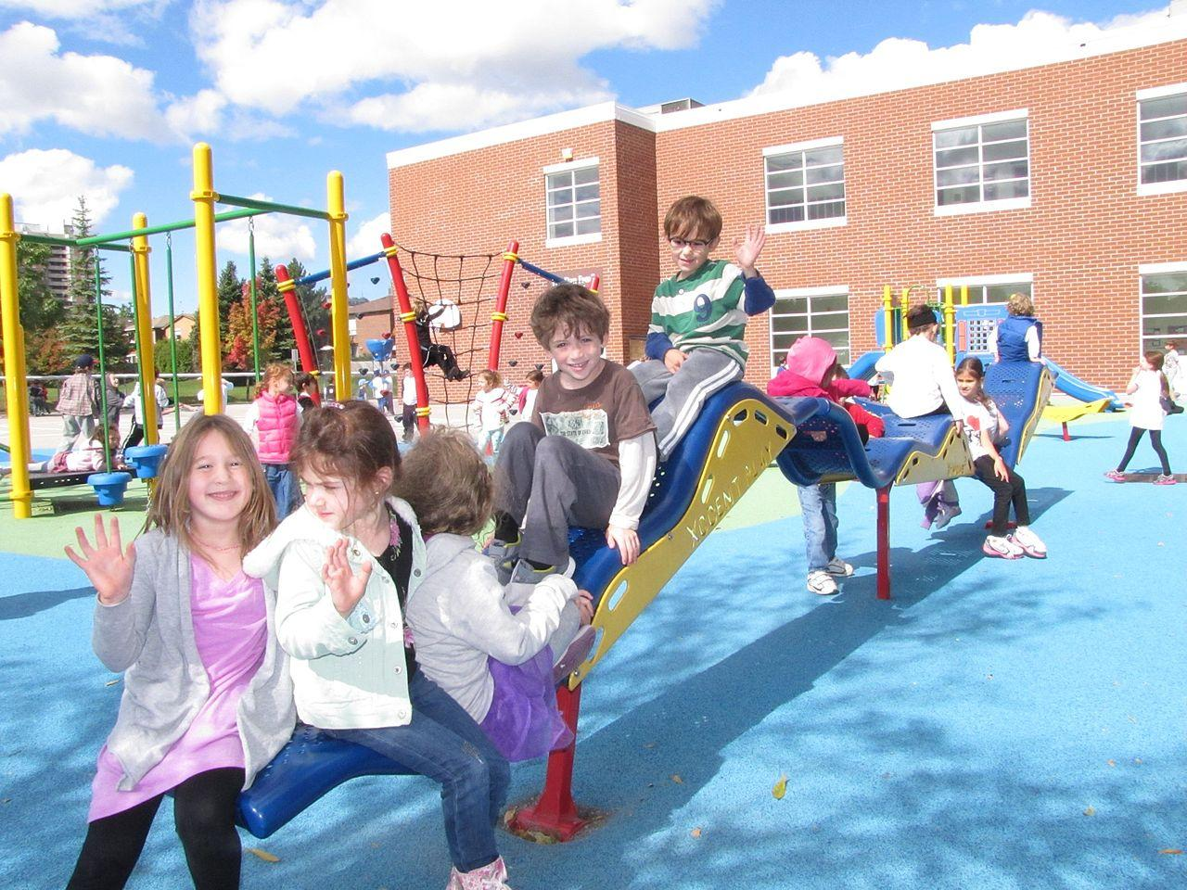
What Can We work on this summer?
Follow an adult’s directions
Play with other children
Eat and use the restroom independently
Take part in a group activity for a short period of time
Ask for help when needed
Show interest in learning
Notes:
Think somewhat abstractly but still need concrete experiences
Can follow directions but like to explore their own ideas
Can think complexly about some things but must think simplistically about others

Slide 40
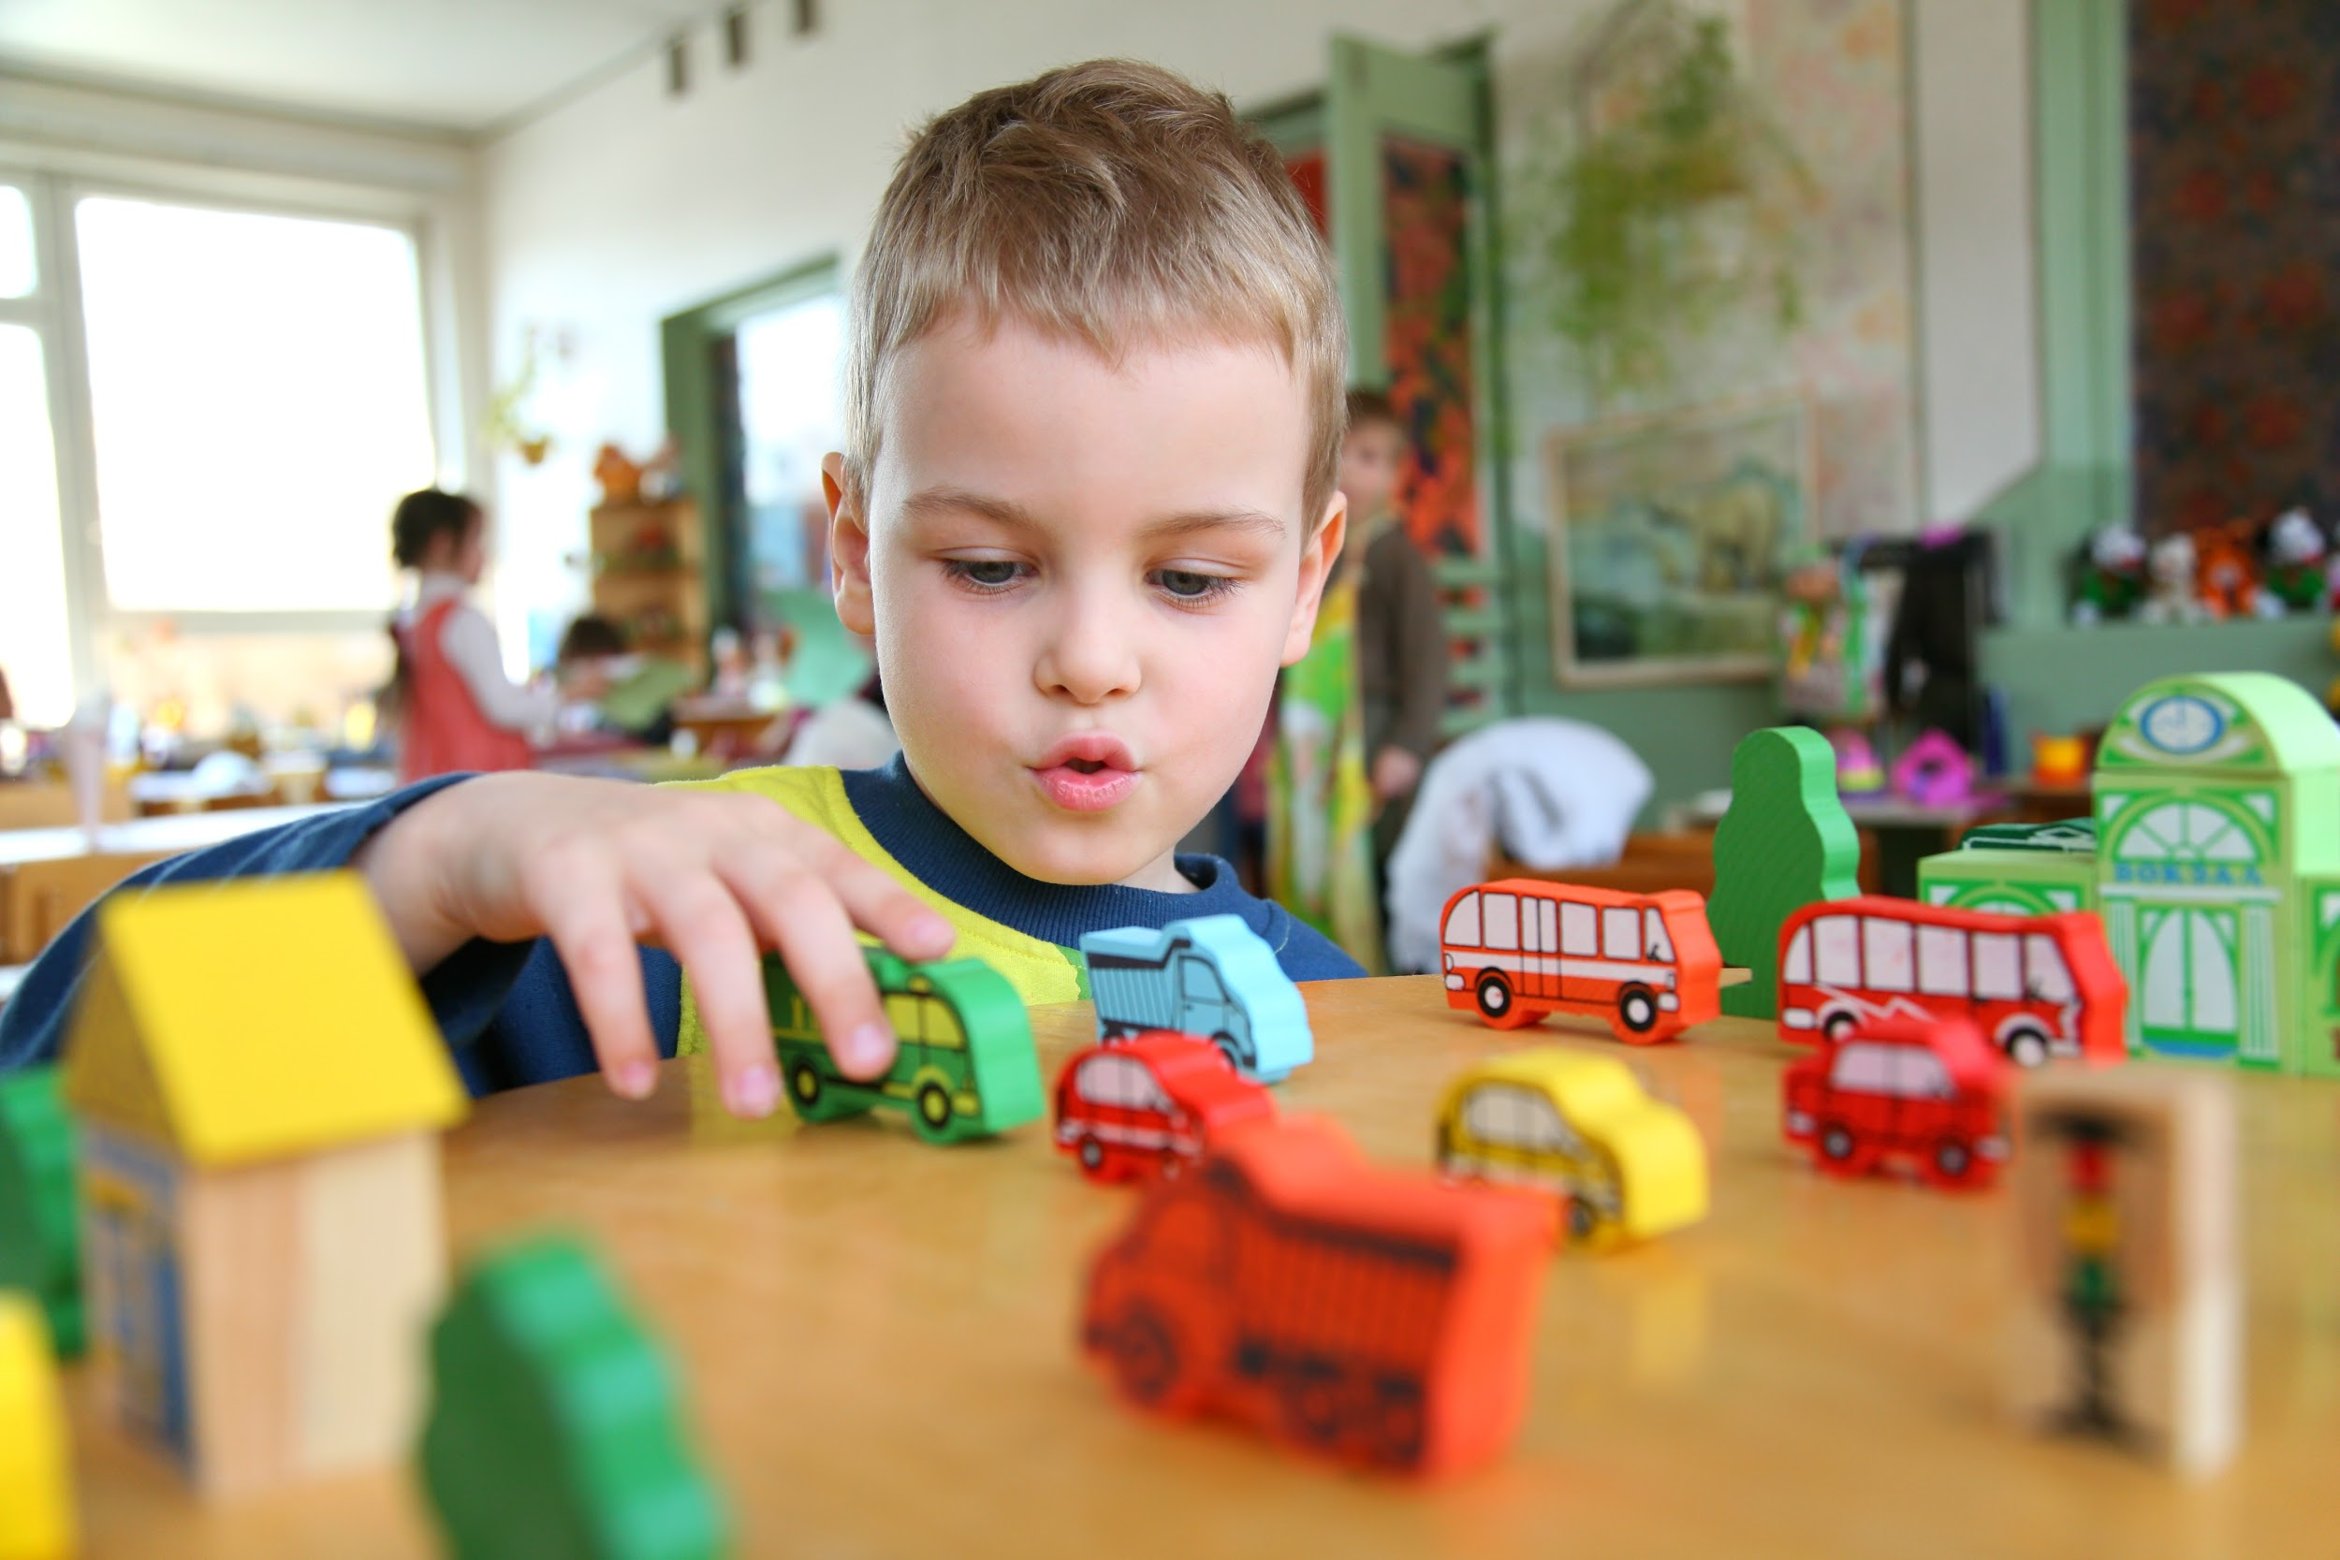
What some children will be able to do before kindergarten
Recognize letters of the alphabet
Read some familiar words
Use crayons and scissors
Count up to 10 objects
Ask and answer questions on topic
These are NOT REQUIRED!

Slide 41
What most children will be doing by the end of kindergarten
Work independently as well as with a group
Use appropriate words and behaviors to handle challenges
Be responsible for organizing own materials

Slide 42
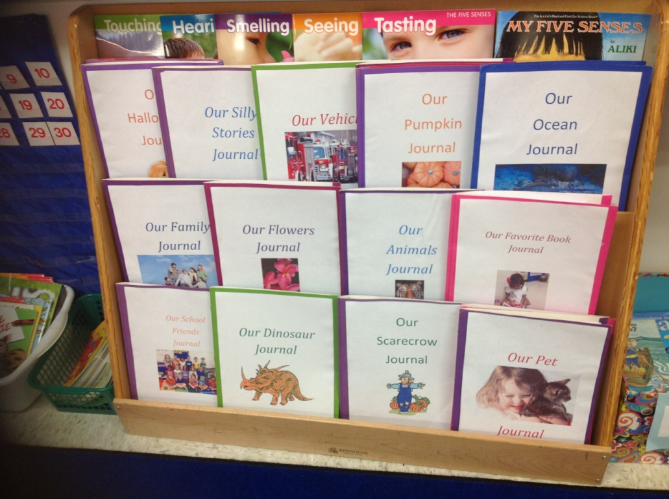
What most children will be doing by the end of kindergarten
Respond to questions about what has been read, taught or experienced.
Identify and use strategies that help readers
Share ideas in writing

Slide 43
What most children will be doing by the end of kindergarten
Add/subtract with numbers up to 15
Participate in designing and conducting basic scientific investigations
+

Slide 44
How do I register?
Step 1: Online Enrollment
Step 2: Document Drop-Off
Step 3 (Maybe): Screening/Language Assessment

Slide 45
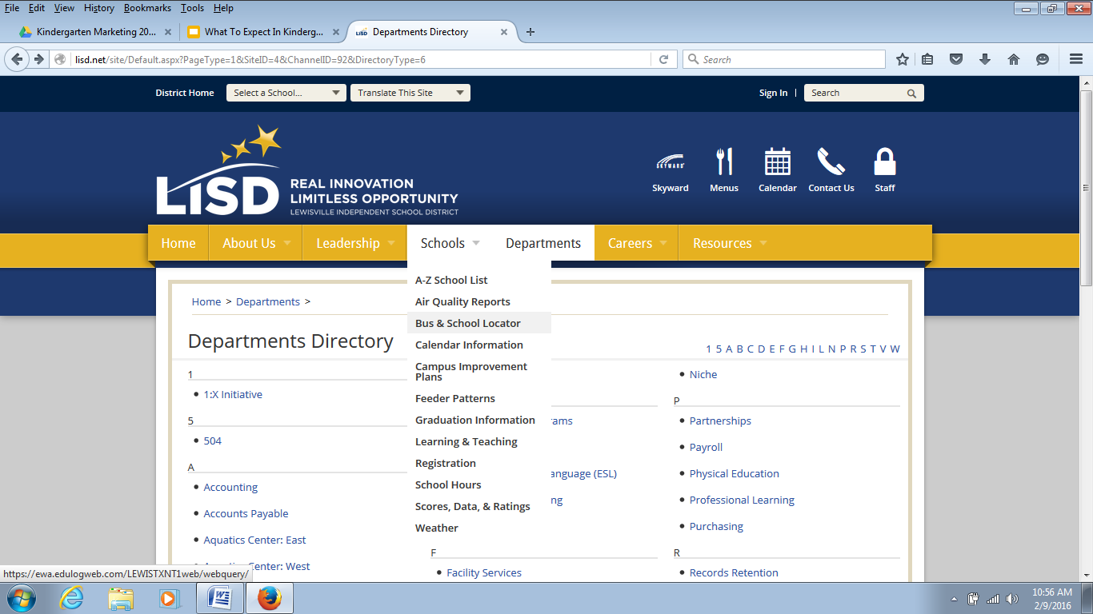
Which school will my child attend?

Slide 46
Which school will my child attend?
May have different assigned campus
Special Education
English Learner in Dual Language Program
Spanish Learner in Dual Language or Spanish Immersion Program
Open Transfers—April 15-29, LISD Student Services Department

Slide 47
Step 1: New Student Online Enrollment
enroll.lisd.net

Slide 48
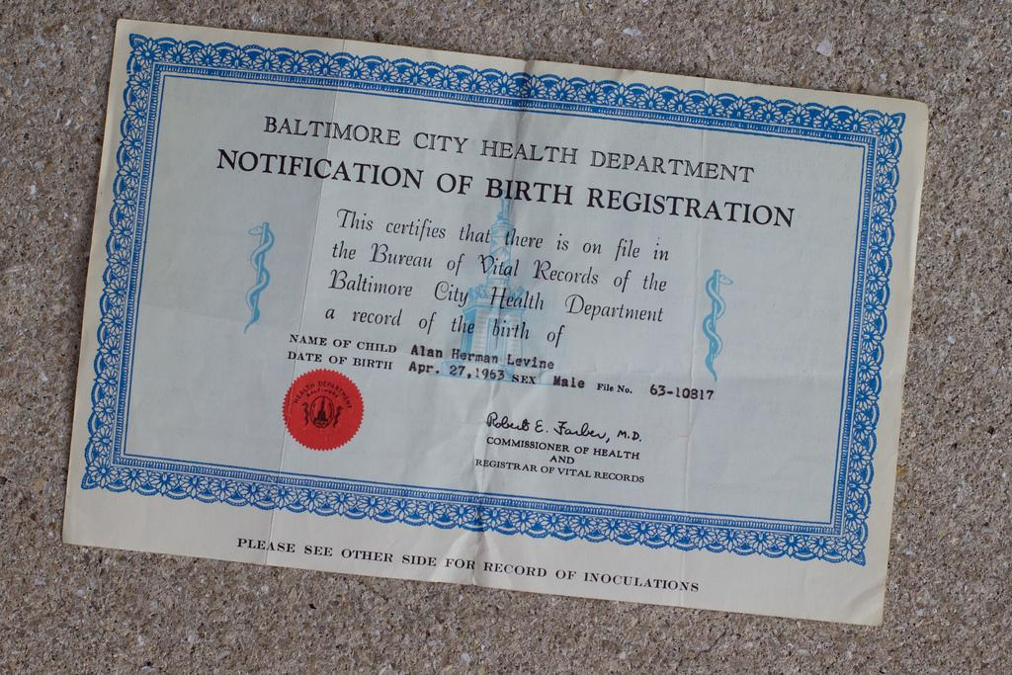
Step 2: Document Drop-Off
April 6-7 —check campus website for time
Bring the registration documents
Not necessary to bring your child, but you may
Receive information about the school

Slide 49
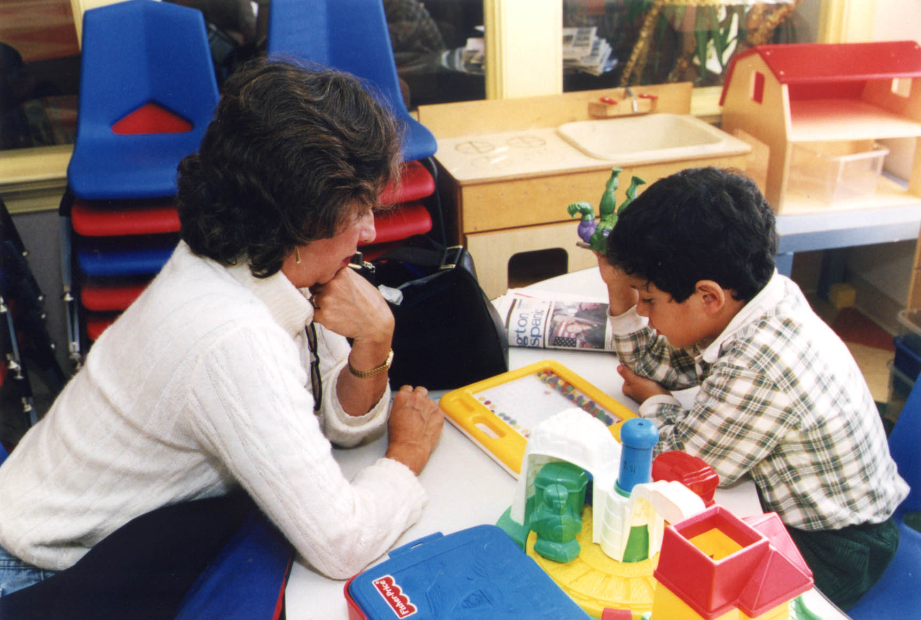
Step 3: MAYBE
Your child may be evaluated for ESL or bilingual program
Staff may do a screening to assist in placement
Quick evaluation of basic early academic and problem solving skills

Slide 50
Throughout the year:
Provide school supplies/materials
Check backpack daily for notes, etc.
Talk with your child about his/her day
Talk with your child’s teacher about any concerns
Encourage your child’s independence
Read to your child daily!
Volunteer
Join PTA

Slide 51
Regular School Attendance
Establishing good habits for life
Be on time
Absent only if ill, emergency, approved religious holy day
Notify the campuses by phone if will be absent; also send note in writing within three days of returning

Slide 52
Preparing Your Child for the Transition to Kindergarten
Resist the urge when your child is around to talk about any anxiety you have about your child going to school
Reassure your child that there will be similarities and differences between where your child is now and kindergarten
Routines and consistency at home will help your child adjust to the routine of school
Read to your child every day!

Slide 53
Questions?
???????

Slide 54
Are you ready for your child to go to kindergarten?

Slide 55
LISD Dual Language Programs
Dual Language Instructional Model
For Students entering
Kindergarten & First Grade
2016-2017

Slide 56
Learning a Second Language at an Early Age…
Builds on their natural sensitivity to the sounds of language
Has a positive effect on intellectual growth, giving students more flexibility in thinking
Improves listening skills
Improves a child’s understanding of his/her native language.
Notes:
Learning another language changes the way the brain works. Young children can more effectively imitate sounds. Around age 7, ability to learn another language naturally begins to fade due to changes in the brain. Can still learn another language, but not as naturally as learned the first.

Slide 57
Learning a Second Language at an Early Age…
Gives a child the ability to communicate with people s/he would otherwise not have the chance to know.
Opens the door to other cultures and helps a child understand and appreciate people from other countries.
Gives a student a head start in language requirements for college.
Increases job opportunities in many careers where knowing another language is a real asset.
Notes:
All around the world, people speak from than one language. Only 1/3 of the tweets on Twitter are in English (MIT study). A 2012 study from Common Sense Advisory, a global business consulting company, shows that it takes 48 different languages to market to 98% of the people on the Internet. The percentage for whom English is the primary language to do online business has dropped from 48-36% since 2012.
In Texas high schools, students need at least two units of a second language. Participation in a dual language program while younger will enable them to reach advanced levels in that language sooner (take AP) or learn another language.

Slide 58
Dual Language Program Goal
To develop fully bilingual,
bicultural and
biliterate students
who at the end of fifth grade,
are able to participate in advanced academics courses at the secondary level.

Slide 59
Two-Way Dual Language
Classroom 1
Group A
Academic Spanish
Classroom 2
Group B
Academic English
Bilingual Teacher
ESL Teacher
Native Spanish Speaker
(English Learners whose parents accepted bilingual services)
Native Speaker of Languages Other Than English
(Spanish Learners whose parents CHOSE for them to become proficient in Spanish)

Slide 60
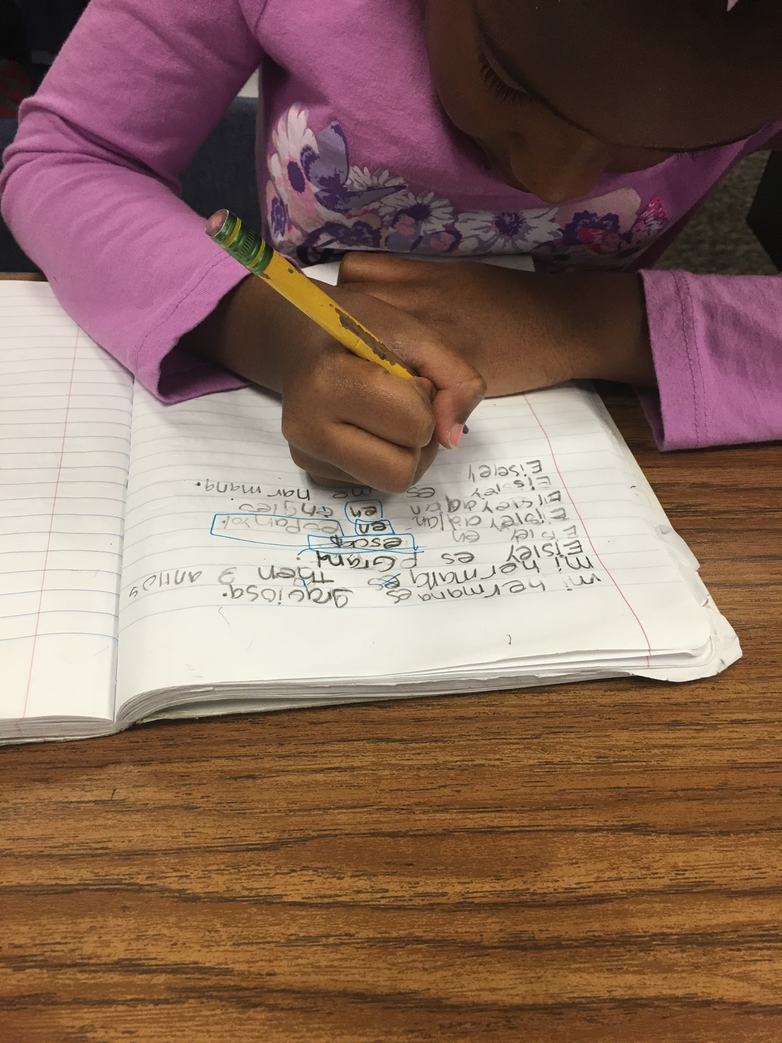
COMBINES
Students being served in the LISD Bilingual Compliance Program
AND
Students whose parents CHOOSE for them to become proficient in Spanish

Slide 61
Why is the Dual Language Instructional Model Effective?
Learning Spanish Through the Content VERSUS Learning Spanish as the Content
Increased time spent in Spanish as compared to traditional models of second language learning
Teaching Languages at an Early Age Capitalizes on the Young Brain’s Ability to Acquire Language

Slide 62
How Long Does It Take?
5-7 years to become fluent in another language
Commitment through fifth grade
Middle School Options available at DeLay, Hedrick, Huffines, Griffin, Killian
Visit the LISD Dual Language - Middle School website for more information.

Slide 63
Notes:
3rd grade student retelling what she read

Slide 64
Elementary Campuses 2016-2017
 | K | 1 | 2 | 3 | 4 | 5
Camey
Peters Colony
Independence
Hedrick
Vickery
Parkway
Southridge
Lakeland
Creekside
Wellington
Hicks
Prairie Trail
Spanish Immersion Campuses

Slide 65
Spanish Language Programs- Secondary
Middle School Language Programs (2016-2017)
Middle School | Feeds into….
DeLay Middle School | Lewisville HS
Durham Middle School | Lewisville HS
Hedrick Middle School | Lewisville HS
Huffines Middle School | Lewisville HS
Griffin Middle School | The Colony HS
Lakeview Middle School | The Colony HS
Killian Middle School | Hebron HS
These schools offer an AP Spanish course. Some offer other content areas in Spanish. Course offerings vary by campus.

Slide 66
Things to consider . . .
Committed to raising a child who knows more than one language—it takes time!
Want my child to have new challenge and opportunity—knowing there will be times when it is not easy
Transportation to the dual language campus if not in the school zone

Slide 67
Supporting Parents Committed to Dual Language Program
Priority given to younger siblings when age-appropriate
If live out of zone:
Older siblings can be assigned to the same campus

Slide 68
Supporting Parents
Parent Collaboratives—training & networking held about 5 times/year
Availability of online Spanish classes (fee)
Website with resources about dual language

Slide 69
Questions

Slide 70
Procedure for Dual Language Placements
Attend a parent information meeting
Submit Request form
Receive email notification
If new to district, enroll child at enroll.lisd.net—then bring registration documents to the dual language campus AFTER receiving email notification
Sign Memorandum of Understanding (MOU) at the campus

Slide 71
http://goo.gl/forms/NTsLmVFnxS
Dual Language Placement Application

Slide 72
Contact Information
Lea Devers : deversl@lisd.net
Anna Murillo: murilload@lisd.net

Slide 76
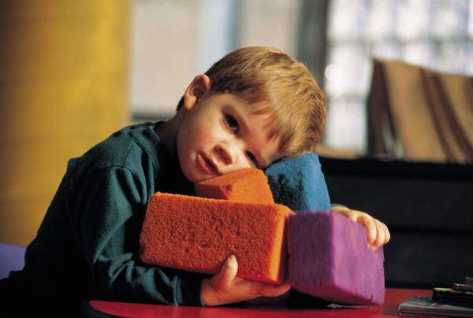
When you ask me what I have done at school, and I say, “I just played,” please don’t misunderstand me. I’m learning to enjoy and be successful at my work. I’m preparing for tomorrow. I am a child and my work is play!

Slide 77
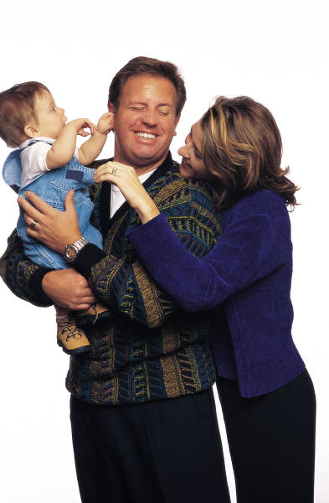
When I am getting all dressed up, setting the table, and caring for the babies, don’t get the idea that I’m “just playing”. I’m learning as I play. I may be a mother or a father or a pediatrician someday!

Slide 78
When you see me learning how to skip, hop, and move my body, I’m learning as I play. I’m learning how my body works.
I may be a doctor someday!

Slide 79
When you see me cooking or tasting foods, I’m learning to follow directions and see differences. I may be a
cook someday!

Slide 80
When you see me sitting in a chair “reading” to an imaginary audience, I’m learning as I play. I may be a
teacher someday!

Slide 81
When you see me combing the bushes for bugs, or packing my pockets with choice things that I find, I’m learning as I play. I may be a scientist someday!

Slide 84
What research says . . .
Delaying entry to kindergarten has little long term benefit
Parents can request a Summary of Research Findings from the LISD Early Childhood Office for more details

Slide 85
What research says about Emotional Development
Emotional development not tied to age.
“Immaturity” may actually be other issues that merit interventions other than delayed entry.
Some studies show higher need for special education services
Adolescents who are older than grade-level peers have been found to have more behavior/discipline issues.

Slide 86
What research says about athletics
Older students may or may not be larger in high school
Most young athletes do not become college or professional athletes

Slide 87
What Research Says about Academic Effects
Staying out another year may result in your child not being challenged.
Parents of older children often want a more advanced curriculum when their children get into kindergarten.
Academic advantage evens out by 3rd grade.
Age at entry is not a major determinant of academic achievement.

Slide 88
What Research Says about the Economics of Redshirting
Immediate impact on family
Another year of childcare costs
Delayed impact
Child will enter workforce at an older age

Slide 89
Why LISD kindergarten?
Certified teachers
No more than 22 children in a class
Curriculum based on State standards
Opportunities for learning academics, independence and making friends
LISD: REAL INNOVATION
LIMITLESS OPPORTUNITY

